Slide 1
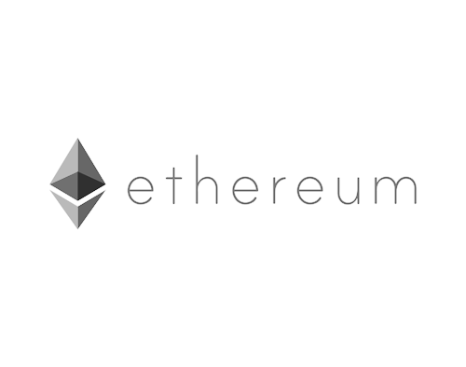

Distributed & Insured delivery smart contract
Students: Yonathan Haimovich and Yuval Kurtser
Supervisor: Alex Manuskin

Slide 2
Agenda
1
Ethereum smart contracts - Intro
2
Problem – Package tracking
3
System requirements
4
Solution
5
Design
6
UI & ABI
7
Operation example
8
Work environment

Slide 3
What is
An open-source, public, blockchain-based distributed computing
platform and operating system.
“A secure decentralized generalized
transaction ledger”
”Transactional singleton machine with
shared-state”
Transaction Are state-changing msgs
(function calls, funds transfer, etc.)
Transaction and payments are being done using underlying crypto
currency called “Ether”, ”Gas” units, and different abstraction “Tokens”
Two Account types:
EOA – Externally Owned Accounts
(controlled by humans or external code)
Smart contracts
(controlled by immutable code)

Slide 4

What are smart contracts?
Smart contracts are Immutable-code based accounts on the Ethereum Block-chain.
Each smart contract account holds:
-Ether Balance
-Storage
-EVM compiled byte code and underlying Application Binary Interface
(ABI)
Smart contracts can send transactions to other smart contracts and to EOAs, and deploy new contracts.
With block-chain’s core characteristics (cryptographically sealed,
distributed, trustless) and underlying crypto currencies, Ethereum’s
Smart contracts versatility is endless:
-Decentralized Banking services ( saving accounts, loans etc. )
-Mass wisdom oracles.
-Decetralized apps.
-and much more

Slide 5
Package tracking
Global online retail sales are growing and are estimated to
reach 8.8% of total retail spending.
Billions of packages are being shipped around the world every year.
Every shipment involves built in risks for all parties involved, from the moment the package is shipped by the vendor, through delivery by the carrier, until it reaches the buyer

Slide 6
Risks
Lost/stolen package
Fraud
Dissatisfied clients
Multiple carriers
Notes:
Lost / stolen packages – package could get lost or stolen anywhere along its route, we wish to avoid losses and when it does happen agree on party who’s responsible for it.
Fraud- Online shopping scams involve scammers pretending to be legitimate online sellers, either with a fake website or a fake ad on a genuine retailer site. We wish to protect buyers from such scams
Unhappy client – package is returned to seller for some reason, double shipping.
Multiple carriers may have different systems for tracking, we want to provide all parties with an easy and transparent way to view most updated package status

Slide 7
Requirements
There is a need for a smart package tracking system that provides
solutions for all the stakeholders in the shipment process:
Trustless
Transparency
Security
Easy interface
Notes:
Trustlessness – terms of deal are agreed prior to shipping, all parties are protected from all risks mentioned.
Transparency - all parties have access to most updated package status at each time. In case of loss, we know who to blame
Security- data is immune to attack of unauthorized
Easy interface- all parties use the app the same way, no need to worry when package changes hands

Slide 8
Solution - Dapp
Decentralized Application (DApp) does not belong to a single provider or
server, but the whole stack are deployed and operated in a
distributed fashion on a peer-to-peer network.
It is a smart contract wrapped in a front end UI, that will provide users:
Resiliancy
Transperncy
Decetralization
Notes:
Resiliency: Having the business-logic written on a smart contract means that a DApp backend will be fully distributed and managed on the Blockchain. Unlike deploying an application on a centralized server, a DApp will have no downtime and will continue to persist as long as the Blockchain is still operating.
Transparency: The open source nature of a DApp allows anyone to fork the code and have the same application running on the Blockchain. On the same note, any interaction with the Blockchain will be stored forever and anyone with a copy of the Blockchain can gain access to it.
Censorship Resistance: As long as a user has access to an Ethereum node, the user will always be able to interact with a DApp without interference from a centralized control. No service provider, or even the owner of the smart contract, could alter the code once it is deployed on the network.

Slide 9
Solution - Dapp
A Dapp as described can meet all the requirements specified
Trustlessness
Transparency
Security
User friendly
Notes:
Trustlessness – each party pays to contract agreed amount of ether. Terms are “agreed” by immutable code of the contract: in case of fraud – money will be returned to buyer, lost package – buyer get money back and seller gets shipping company deposit
Unhappy client -Package is returned to seller and client pays for delivery. If seller won’t sign it back - pkg goes to under dispute state, waiting for the dispute resolver to resolve the case.
Transparency - by the nature of ethereum
Security – built in the contract, only seller, client and shipper can sign a package
Easy interface – android app and QRcode

Slide 10
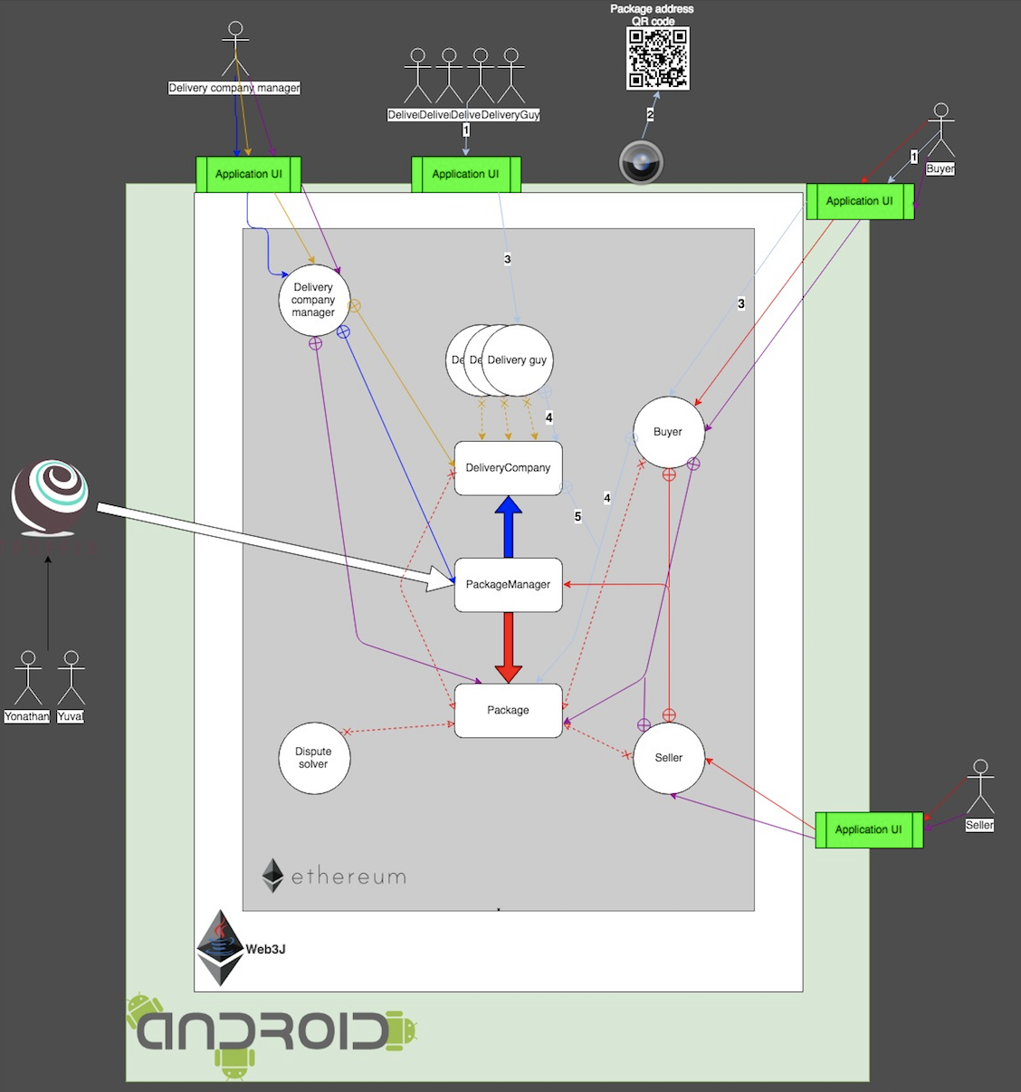
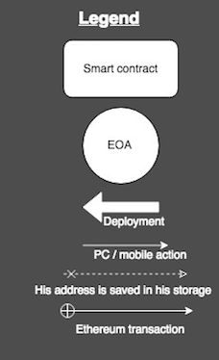
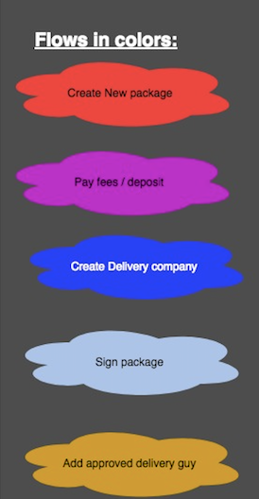
Design

Slide 11
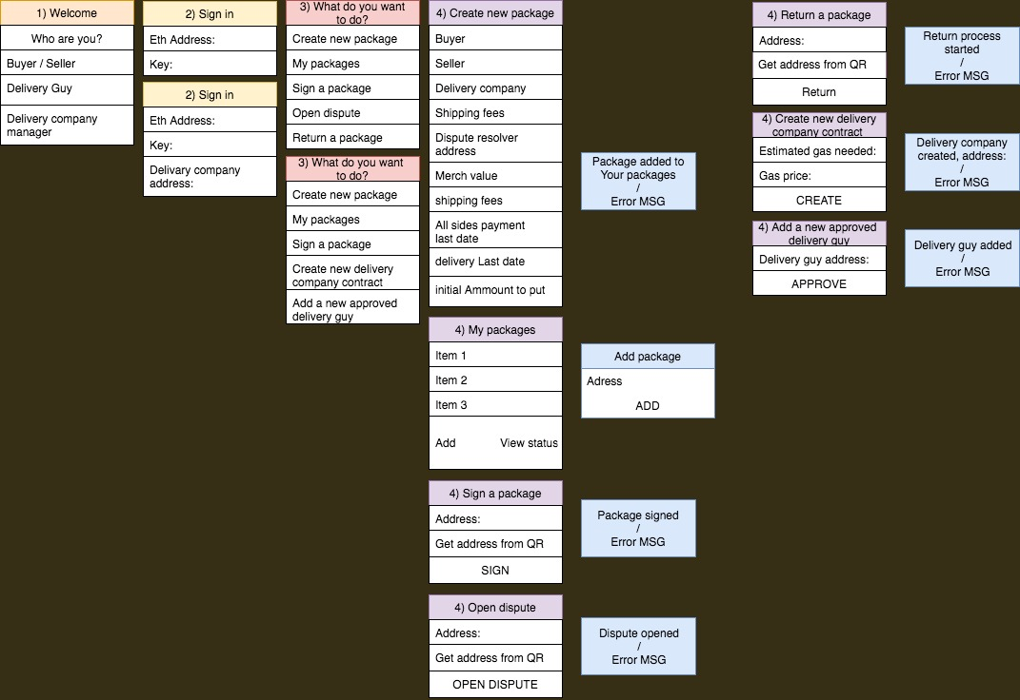
App UI Abstraction

Slide 12
Contract: PackageManager
main responsibility is to create a new package contract, when has all required information
Also creates delivery company contracts
Deployed once by us
Collects profit

Slide 13
Contract: PackageManager
Members:
Address owner
Functions:
createPkg()
arguments:
Address seller
Address shipmentCompany
Address buyer
Address disputeResolver
float merchValue
float shippingPrice
int maxShippingDays
returnes:
created pkg address
claimExcessEth()
requirements:
sender==owner
createDeliveryCompany()
returns:
DeliveryCompany address

Slide 14
Contract: DeliveryCompany
Provides another layer for secure access to package- an
adaptor
Allows multiple signers/stations while keeping delivery company responsible, only owner will be able to sign package directly.
Easy to have multiple delivery companies with different policies, while keeping the same interface.

Slide 15
Contract: DeliveryCompany
Members:
Set deliveryStations - key: stationAddress
Address Owner
Functions:
addDeliveryStation()
requirements:
msg.sender == owner
arguments:
Address deliveryStation
Returnes:
True/False
removeDeliveryStation()
requirements:
msg.sender == owner
arguments:
Address deliveryStation
returnes:
True/False
signPkg()
requirments:
msg.sender is in deliveryStationsSet
arguments:
Address Package
Returns:
True/False

Slide 16
Contract: Package
Contains all necessary information of package
Public addresses of stake holders
Can be deployed by either party
Trajectory updated by signing
resolve payments

Slide 17
Contract: Package
Members:
enum State {WaitingForStakesIn, Shippable, Shipped, Returned, UnderDispute}
Address sender
Address shippmenpCompany
Address buyer
Address disputeResolver
float merchValue
float shippingPrice
float ammountBuyerPaid
float ammountShippingCompanyPaid
float ammountSellerPaid
Date arrivalLastDate
Date waitingForStakesInLastDate
list<string>trajectory

Slide 18
Contract Package
Functions:
[payable]
requirements:
arguments:
functionality:
-raise paid amount of corresponding side
-check if state can be switched
signPkg()
requirements:
Msg.sender check according to state
arguments:
String - location description
returnPkg()
requirements:
state==shipped and msg.sender==buyer
arguments:
string reason
resolveDispute()
requirements:
state== UnderDispute
and
msg.sender==disputeResolver
arguments:
float sellersCut
functionality:
pays back money according to dispute
solver decision, than self distruct
checkStakesInTimeOver()
requirements:
state==WaitingForStakesIn
functionality:
if date>waitingForStakesInLastDate ,
return payed ammount to each party and
self distruct
openDispute()
requirements:
state==returned
and
msg.sender == shipmentCompany functionality:
changes state to UnderDispute
checkDeliveryTimeOver()
requirements:
state in [shipped, returned]
functionality:
if date>arrivalLastDate,
return money and self distruct

Slide 19



Work and development Environment
EVM compilation, deployment and RPC access to block-chain are being done using Truffle framework and the truffle console.
At early stages, deployment and testing we’ll be done on local Ethereum blockchain created and maintained by Ganache.
At later stages, contracts will be deployed to ropsten test-net blockchain.
Android development will be done in Android studio

Slide 20
Questions
?

Slide 21
Thank you !

